Slide 1
Internet of Things Starter Workshop
Danil Borchevkin
Danil.Borchevkin@Lab409.ru
+79114692217
Kaliningrad
2018

Slide 2

Who am I?
Danil Borchevkin;
28 years;
Married;
Master of EE (IKBFU, 2014);
Owner Lab409 LLC;
More a engineer than businessman =((
Main skills – Electrical Engineering, PCB Design, Firmware Engineering, Electronic Design.
Points of interest: RF, ARM, MSP43x, Tiva C, EFM32, STM32, Cloud-backends

Slide 3

Part 1 What is IoT exactly
#history #technology #peoples

Slide 4

Evolution of Industry

Slide 5
History of IoT
198x – D2D conception.
1990 – first connected thing – a toster with embedded TCP/IP abilities.
1990 – several guys in Sun Microsystems start develop new language for embedded systems.
199x – M2M expansion (POS, ATM, banking).
1999 – IoT named IoT by Kevin Ashton (MIT, Auto-ID) during presentation for Procter & Gamble (RFID for logistics).
2004 – article in Scientific American about IoT conception.
2008 – USIC named IoT one of six dangerous technologies.
2009 - borning of IoT – amount of things exceeded people’s population.
2011 - Gartner named Iot as «tech trigger» with 10 years time of shaping.

Slide 6
M2M is a complex of techs but not a concept
Machine-to-Machine, M2M is a common name of technologies which purposed to machine connect with other machine (simplex/duplex):
Secuirity systems.
POS.
ATM.
Vending.
Fleet tracking.
Main techs: GSM/GPRS, GNSS (GPS, Galileo, Glonass and so on), Wired/Wireless common and industry-specific protocols.

Slide 7
IoT is a conception but not a technology
IoT is a conception of network consist of physical objects(«things») which enable these objects to collect and exchange data. The IoT allows objects to be sensed or controlled remotely across existing network infrastructure creating opportunities for more direct integration of the physical world into computer-based systems, and resulting in improved efficiency, accuracy and economic benefit in addition to reduced human intervention.
IoT based on:
Embedded systems (electronics+firmware+mechanics+optics+chemistry)
Connectivity (Wired and Wireless protocols and high-level protocols).
M2M.
Internet.
Data analytics.

Slide 8
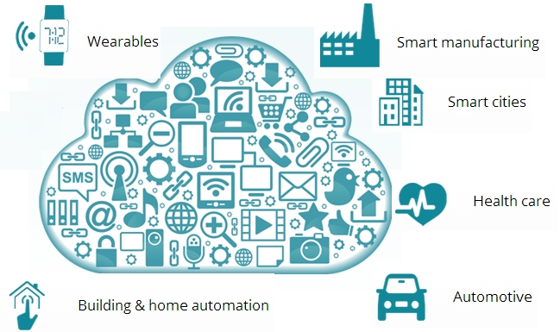
IoT is a… infrastructure. A network of networks
"Instruct the children not to dream of toys or sweets. Instruct them to dream of infrastructure." Vadim Kozlov, Axioms from the Minutes of the Central Directorate
Civilization. Beyond the Earth

Slide 9
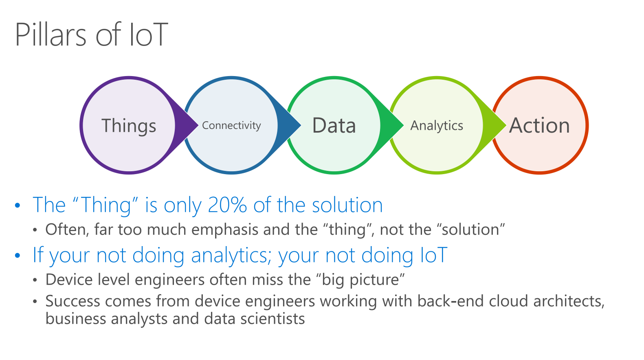

Slide 10
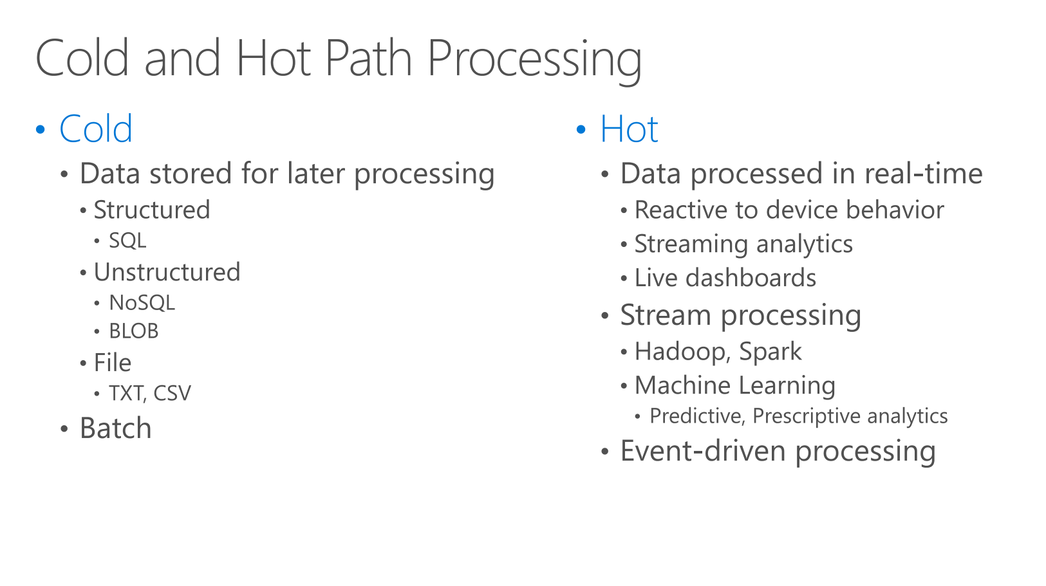

Slide 11
Part 2 Ground Level of IoT
#embedded #things #connectivity

Slide 12
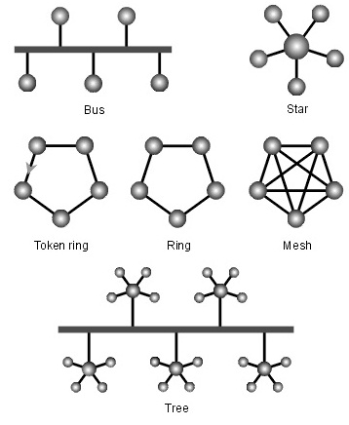
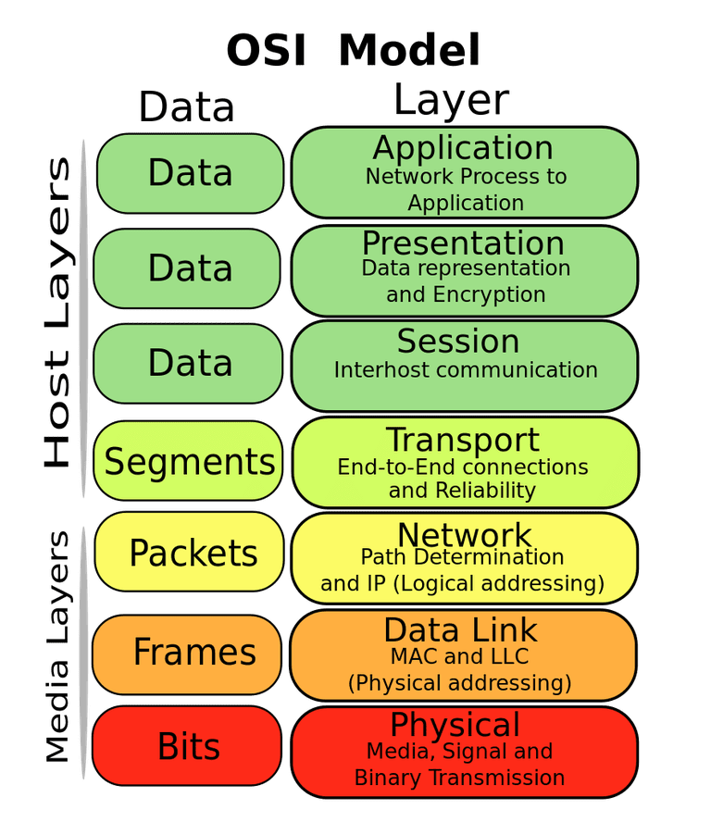
Some theory

Slide 13
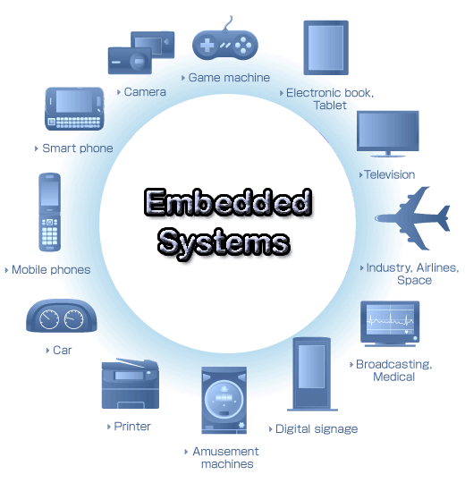
Embedded systems
Typical embedded system consist of:
Electronics;
Firmware;
Chemical things;
Mechanical things;
Optical Things.
“Thing” is embedded system with M2M abilities (wired/wireless protocol)

Slide 14
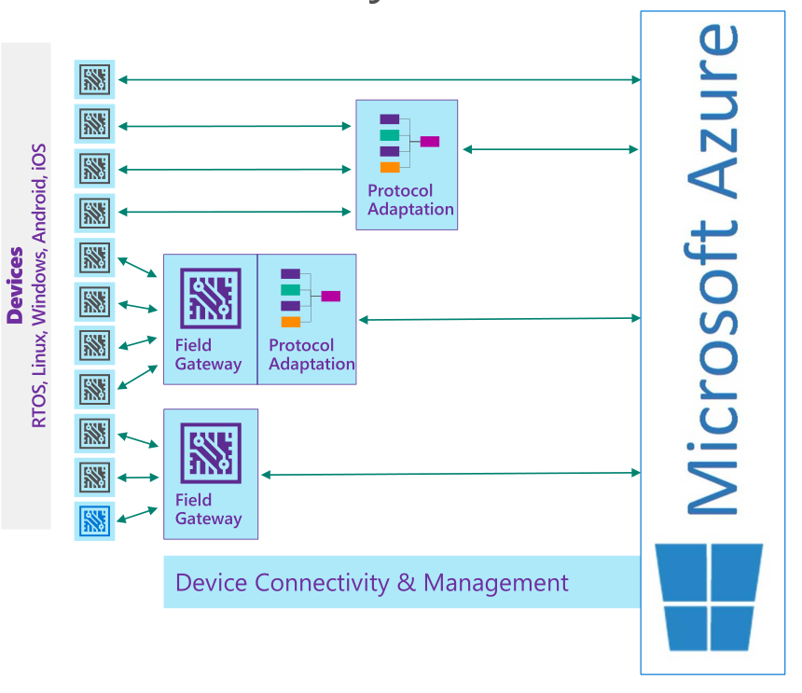
Connecting ways
IoT not mean what all things have direct internet connection.
Many things have to connect to cloud over gateways and adaptation servers.
It’s all about economy and processing issues.

Slide 15
Wired protocols (low-levels)
Ethernet;
RS-422;
RS-485;
Fiber Optics;
CAN;
And Industry-specific.

Slide 16
Wireless protocols (all levels)
Out of category – all types of barcodes;
RFID/NFC;
Bluetooth (Classic and Smart);
802.11 based – WiFi, etc;
802.15.4 based noIP – ZigBee, etc;
802.15.4 IP-based – 6loWPAN – Thread, etc;
Proprietary RF in 2.4 GHz
Proprietary RF in ISM (Sub 1GHz) – 433, 868/915 MHz – Z-Wave, etc;
GSM/GPRS 2G/3G/4G/5G;
Latest WAN – LoRA, NB-IoT, SigFox.

Slide 17
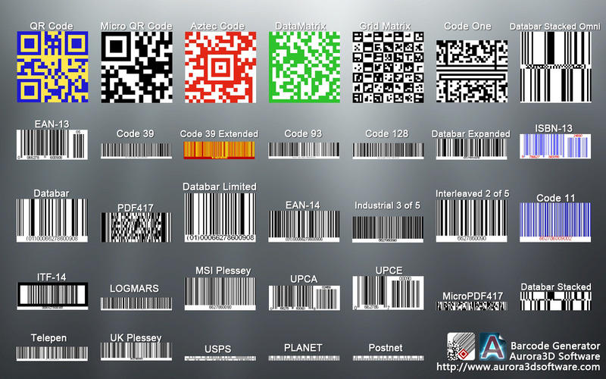
Barcodes

Slide 18
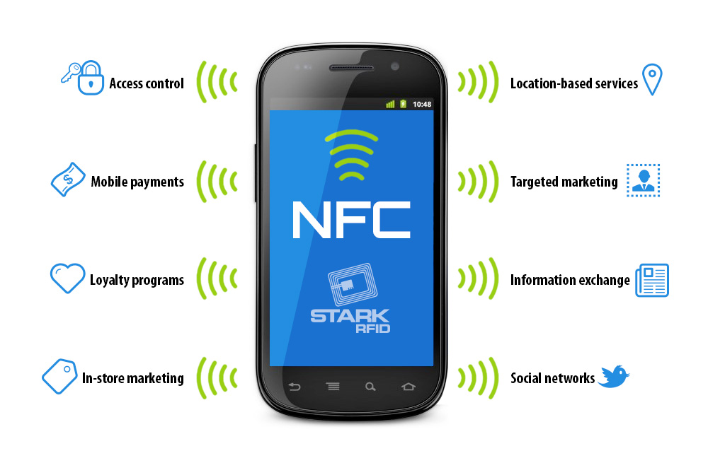
RFID/NFC

Slide 19
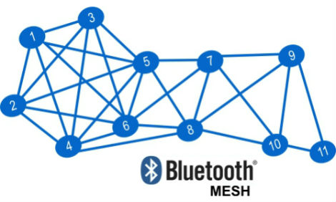
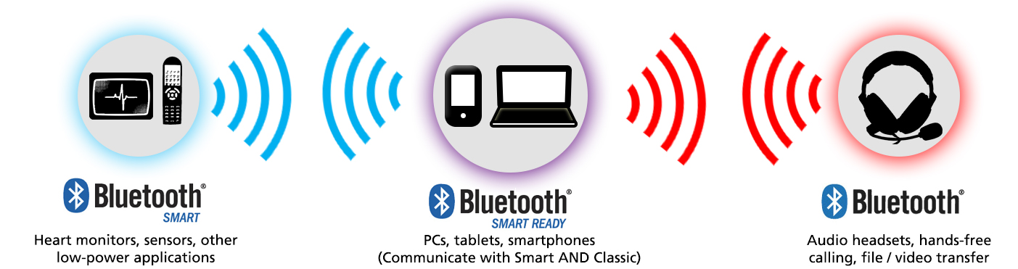
Bluetooth

Slide 20
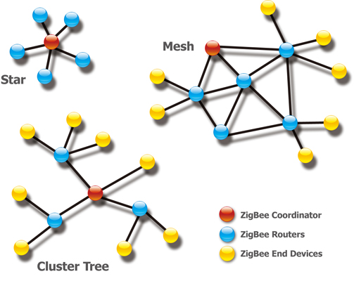
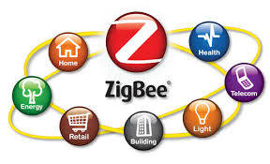
ZigBee – 802.5.14 most popular protocol

Slide 21
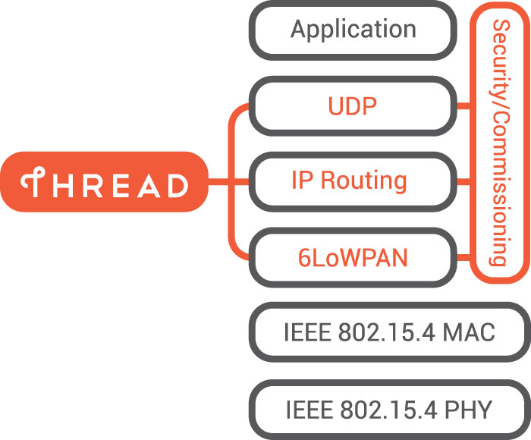

6loWPAN and based on it. Thread

Slide 22
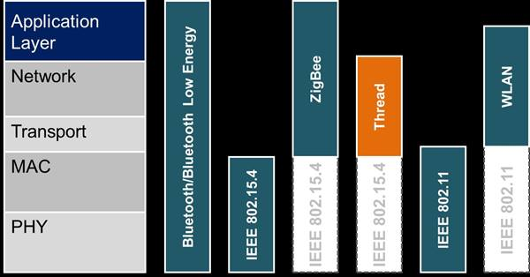
About protocols

Slide 23
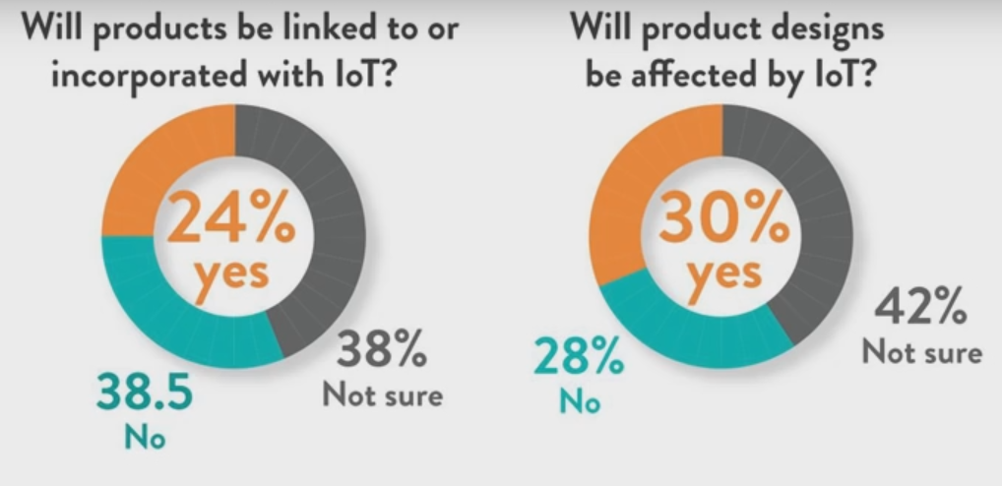
What engineers think about IoT

Slide 24

Part 3 Cloud services for IoT
Do Internet of Things but not a Thing-in-itself

Slide 25
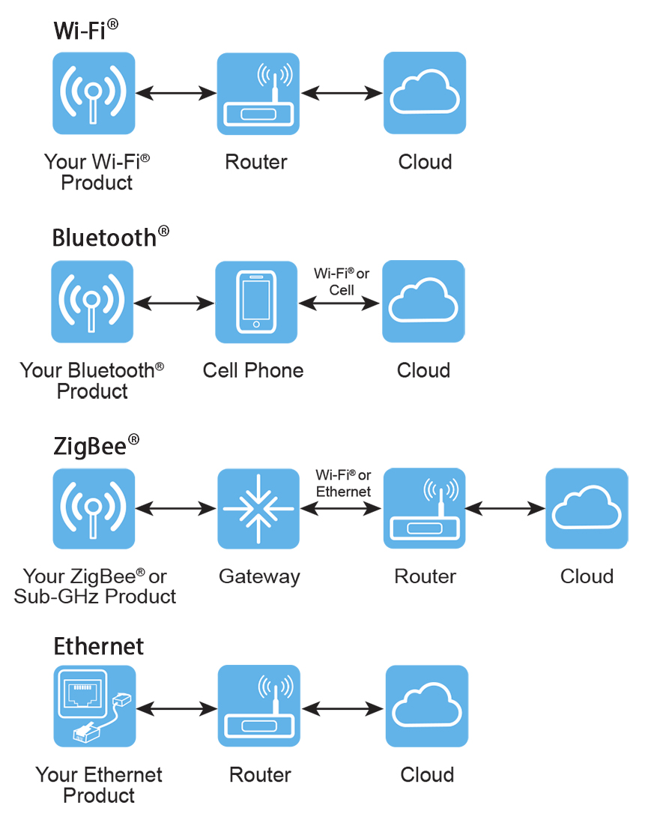
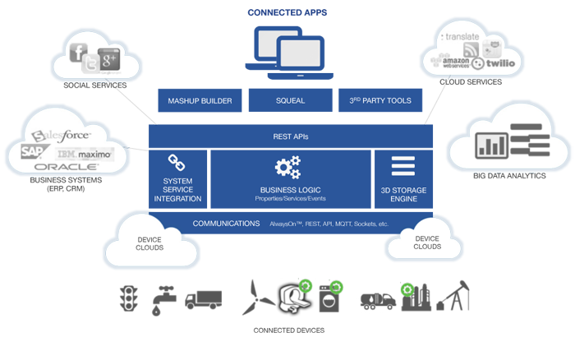
How clouds implement systems for IoT

Slide 26







Popular IoT clouds

Slide 27
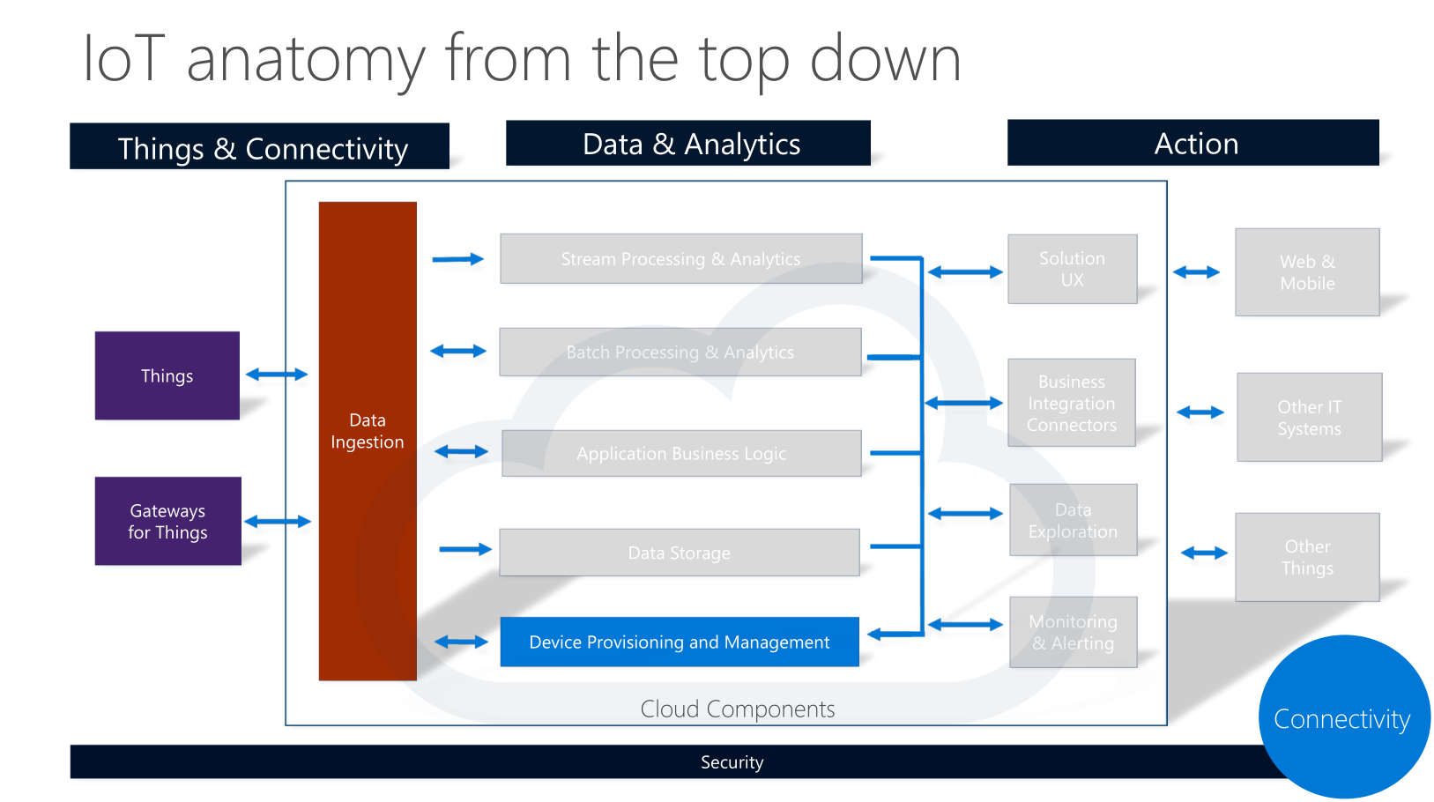

Slide 28
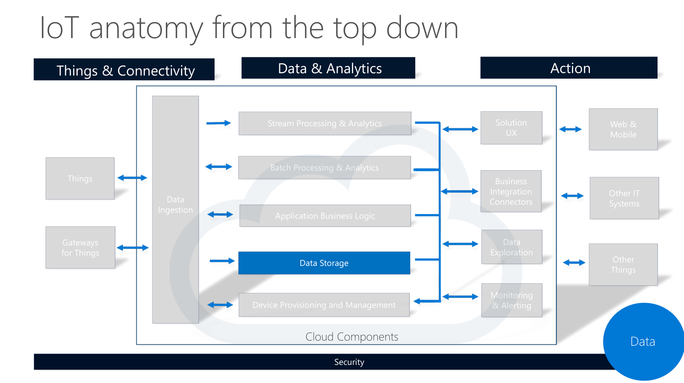

Slide 29
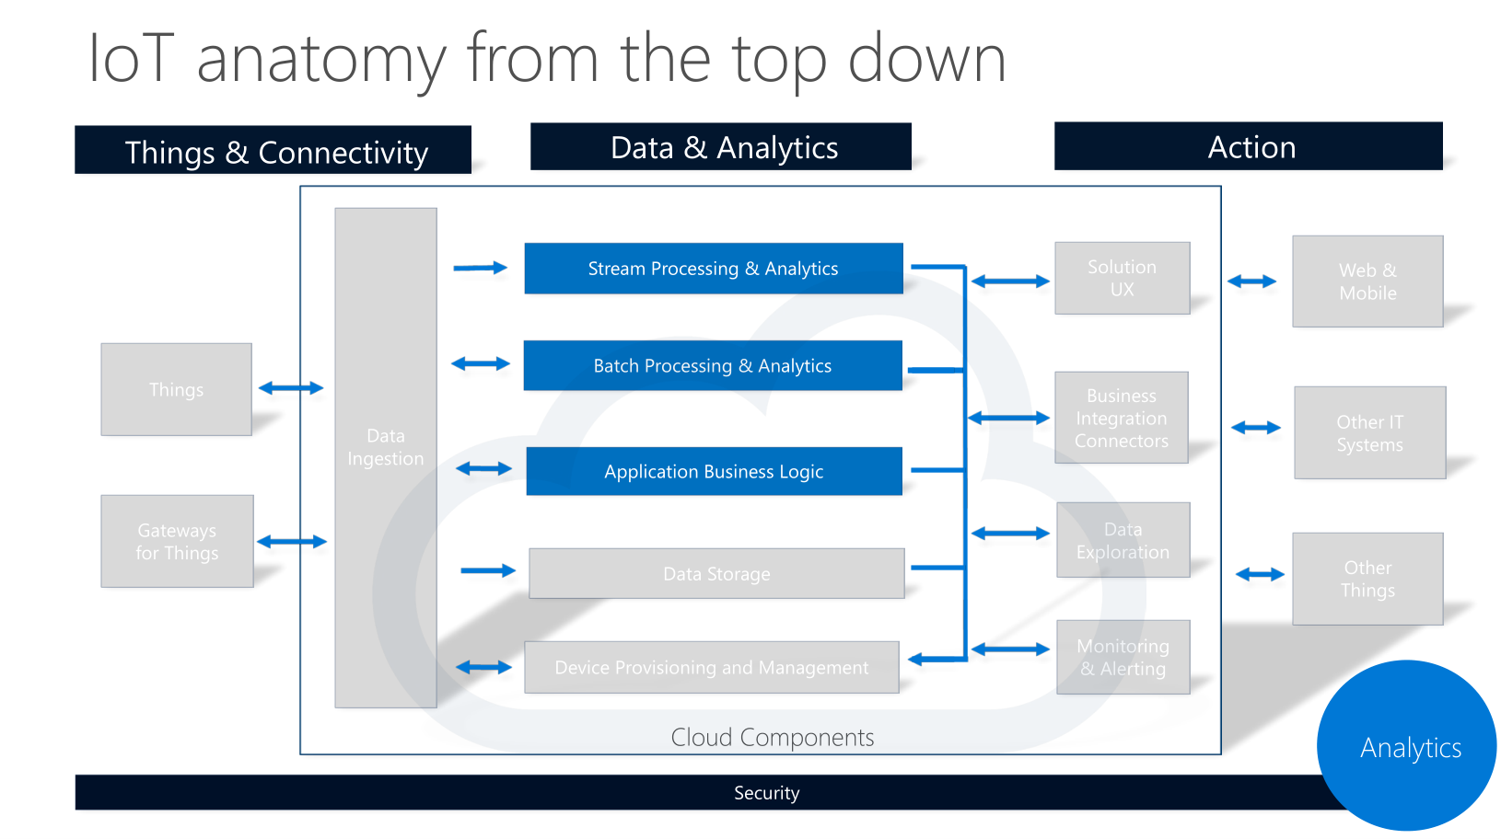

Slide 30
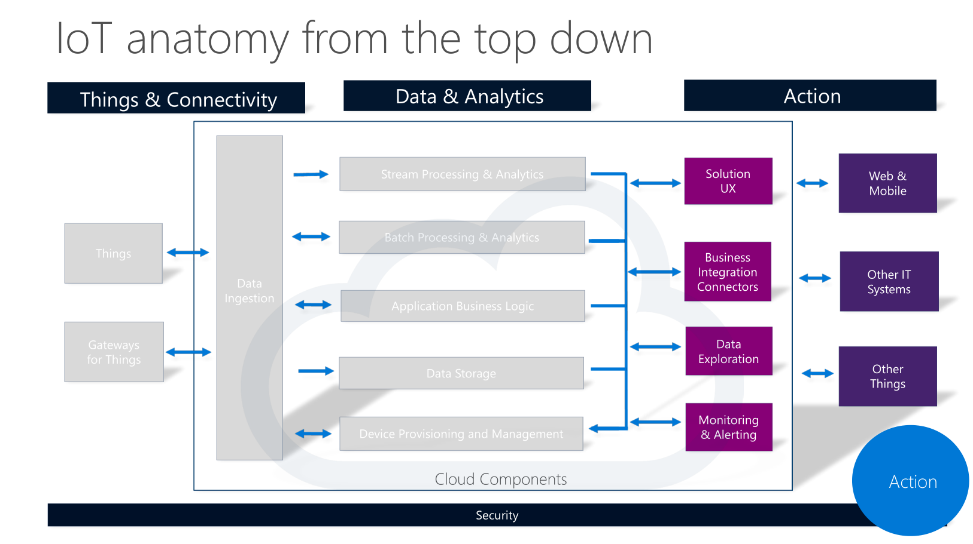

Slide 31
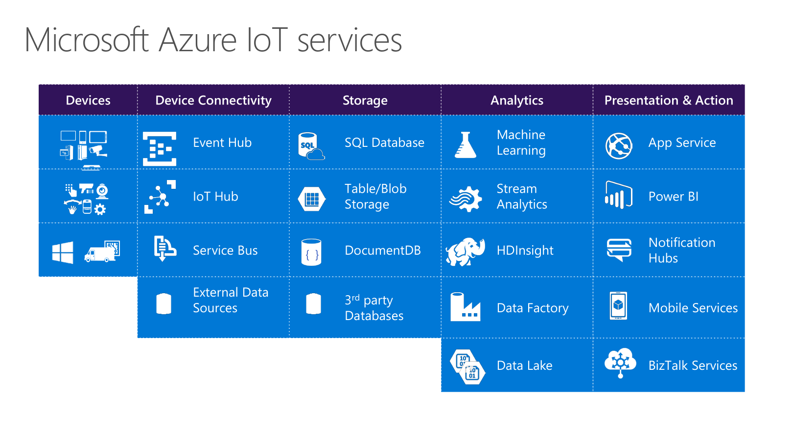

Slide 32
Some issues in Russia
No alternatives to GSM/GPRS (upd. NB-IoT is coming) as a WAN;
Customs issues;
“Strange” logistic;
“Russian business”;
High prices of components, devkits;
There are no Russian competitors on a microelectronic market;
Availability of new components (domestic resellers): +1 year from release.

Slide 33
Part 3 Labs
#lab #mediatek #OpenWRT

Slide 34
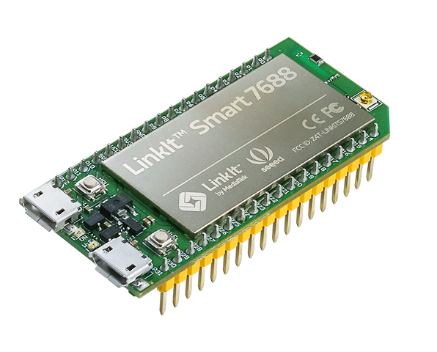
Core of your “thing” – MediaTek LinkIt Smart 7688
OpenWRT
Single input single output(1T1R) Wi-Fi 802.11 b/g/n.
Pin-out for GPIO, I2C, I2S, SPI, UART, PWM and Ethernet Port.
580 MHz MIPS CPU.
32MB flash and 128MB DDR2 RAM.
USB host.
Micro SD slot.

Slide 35
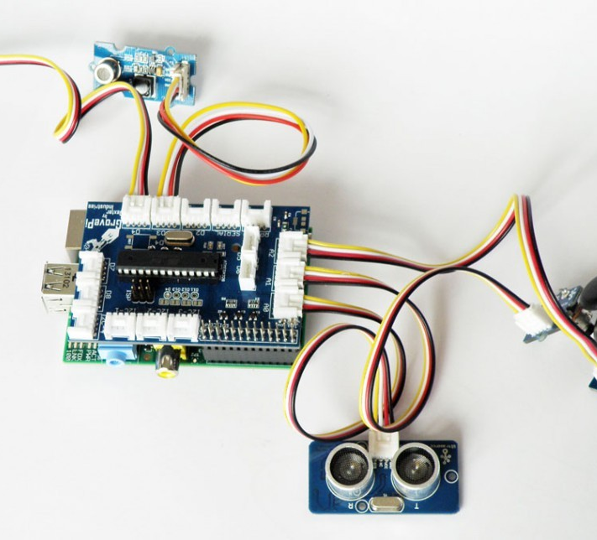
Grove actuators and sensors
150+ ready sensors and actuators
Ready code and examples for main platforms
No PCB development and soldering needed
Good to quick start and PoC

Slide 36

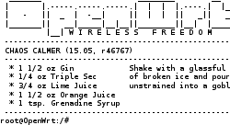
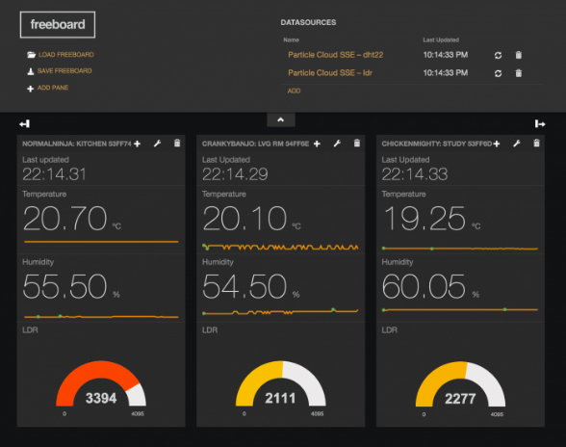
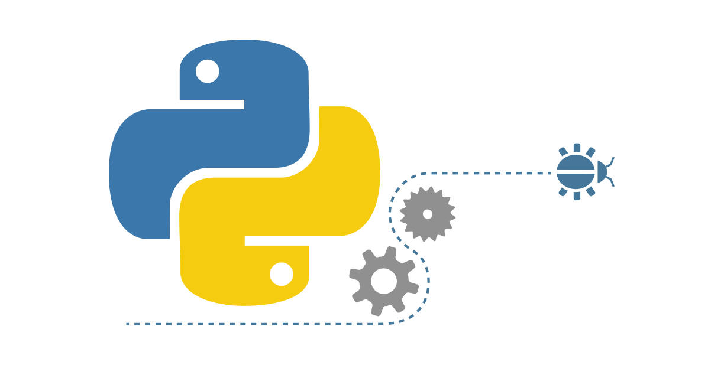
Software
Your “thing” has a OS OpenWRT. It’s a good news for start!
For your “thing” you can write code on high-level languages – Python, Node.JS, Lua…
For own workshop we will use free cloud backend dweet.io with visualizing tool freeboard.io
As we have OS so we can connect to own “thing” by SSH

Slide 37
Lab 01 - Blink
Your script placed at ~/ws_iotstarted/lab01/lab01.py
Change directory by cd command
Open the script by nano
Following instruction in the code
Then exit from nano by pressing Ctrl+X
Run code by ./lab01.py
If you want to exit from script press Ctrl+C
Finish!

Slide 38
Lab 02 – First sensor
Your script placed at ~/ws_iotstarted/lab02/lab02.py
Change directory by cd command
Open the script by nano
Following instruction in the code
Then exit from nano by pressing Ctrl+X
Run code by ./lab02.py
If you want to exit from script press Ctrl+C
Finish!

Slide 39
Lab 03 – Send data to cloud
First – finish registration on http://freeboard.io
Your script placed at ~/ws_iotstarted/lab03/lab03.py
Change directory by cd command
Open the script by nano
Following instruction in the code
Then exit from nano by pressing Ctrl+X
Run code by ./lab03.py
If you want to exit from script press Ctrl+C
Go to http://dweet.io and verify data ingestion
Go to http://freeboard.io and build your dashboard
Finish!

Slide 40
Lab 04 – Be connected
Show your soft-skills – if you have sensor find another participant with actuator and vice verca
Your script placed at ~/ws_iotstarted/lab04/lab04_actuator.py or ~/ws_iotstarted/lab04/lab04_sensor.py (depence from your “thing”)
Change directory by cd command
Open the script by nano
Following instruction in the code
Then exit from nano by pressing Ctrl+X
Run code by ./lab04_sensor.py or ./lab04_actuator.py
If you want to exit from script press Ctrl+C
Finish!

Slide 41

Danil Borchevkin
+7 911 469 22 17
Danil.Borchevkin@Lab409.ru
Lab409.ru

